Slide 1


DL
Autoencoders

Slide 2
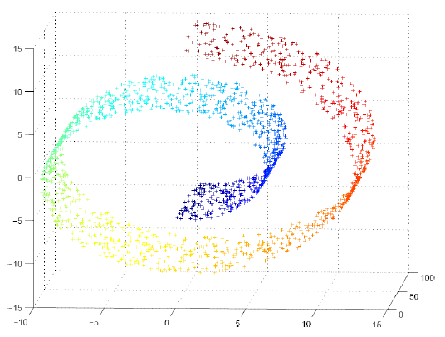
Manifold
Manifold is a connected region.
In ML, it is connected set of points that can be approximated well by considering only a small number of degrees of freedom, or dimensions, embedded in a higher-dimensional space.
Interesting inputs occur only along a collection of manifolds containing a small subset of points.

Slide 3
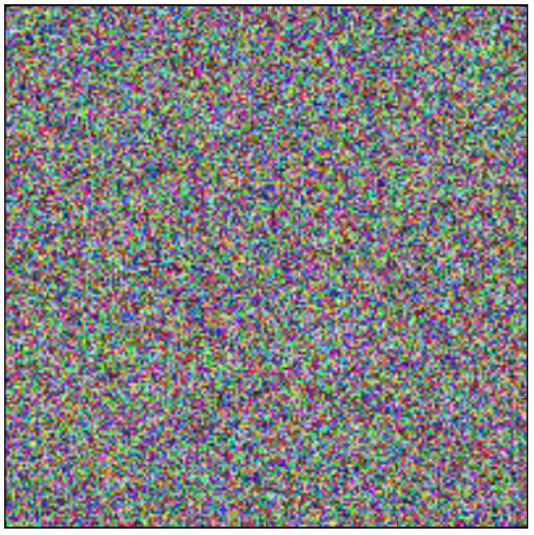
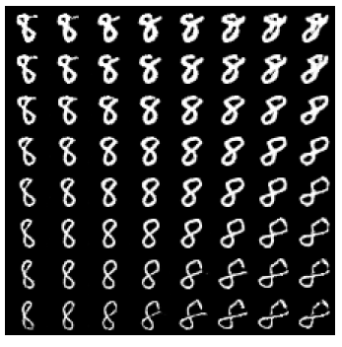
Manifold
Assumption: the real world data lies along a low-dimensional manifold
Observation 1.
Probability distribution over images, text, and sounds that occur in real life is highly concentrated.
Observation 2.
The data is surrounded by other highly similar examples that can be reached by applying transformations to traverse the manifold.

Slide 4
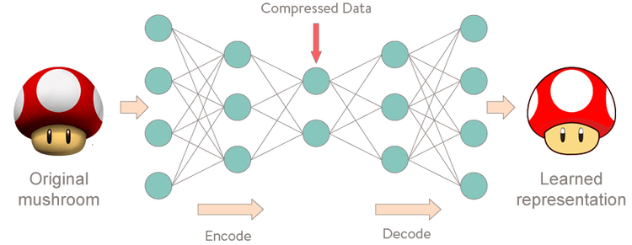
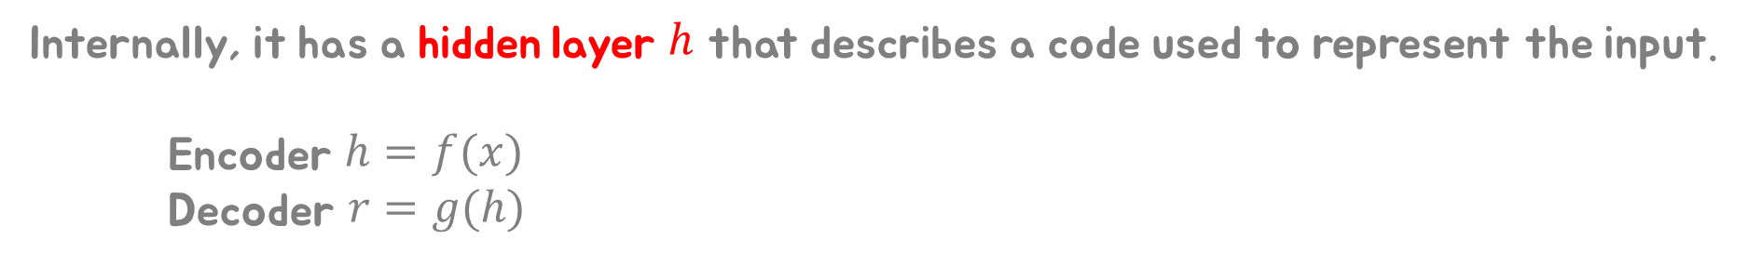
What is Autoencoder?
Autoencoder is a neural network that is trained to copy its input to its output.
Internally, it has a hidden layer $h$ that describes a code used to represent the input.
Encoder $h=f(x)$
Decoder $r=g(h)$

Slide 5
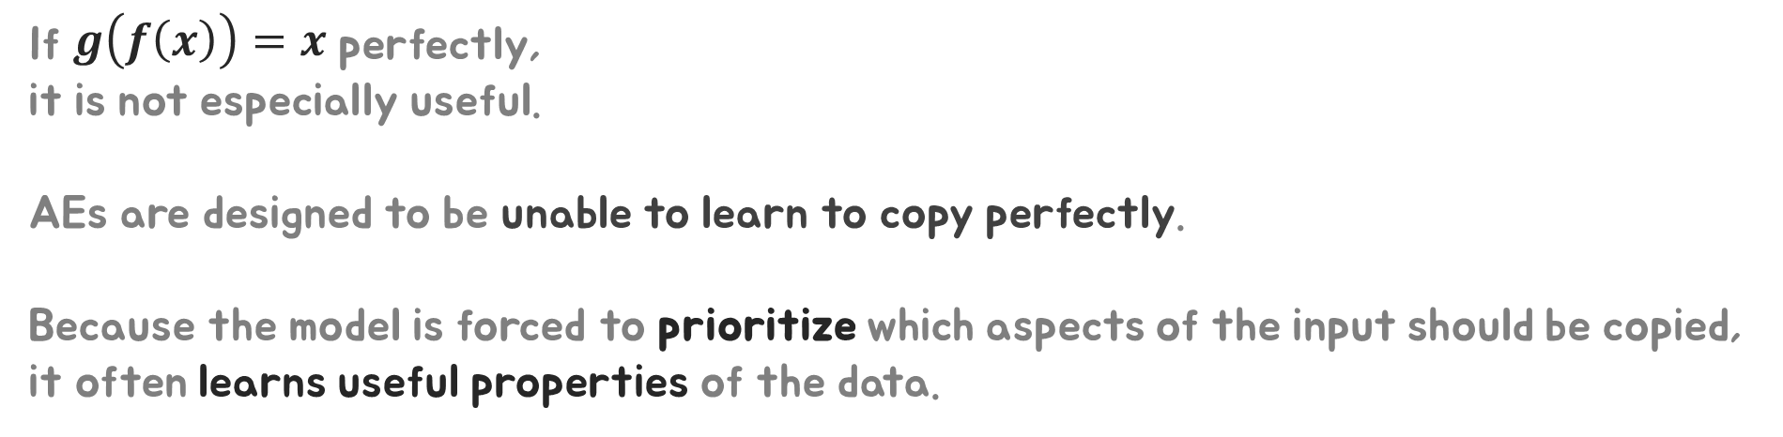
What is Autoencoder?
If $g\left(f\left(x\right)\right)=x$ perfectly,
it is not especially useful.
AEs are designed to be unable to learn to copy perfectly.
Because the model is forced to prioritize which aspects of the input should be copied, it often learns useful properties of the data.

Slide 6
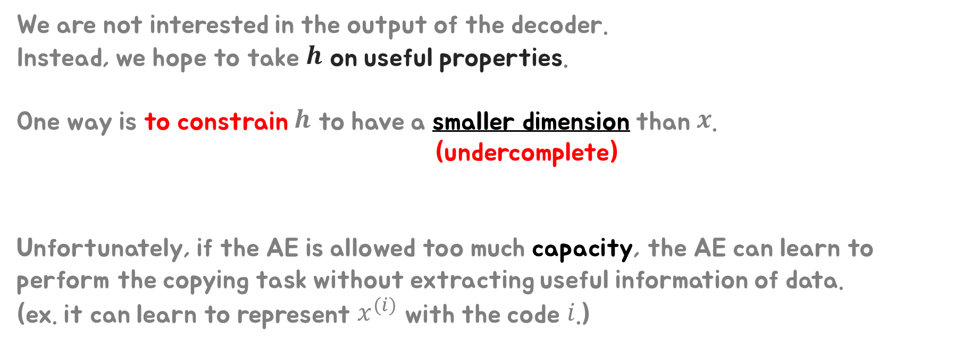
Undercomplete Autoencoders
We are not interested in the output of the decoder.
Instead, we hope to take $h$ on useful properties.
One way is to constrain $h$ to have a smaller dimension than $x$.
(undercomplete)
Unfortunately, if the AE is allowed too much capacity, the AE can learn to perform the copying task without extracting useful information of data.
(ex. it can learn to represent $x^{(i)}$ with the code $i$.)
When the decoder is linear and Loss is the MSE, an AE learns to span the same subspace as PCA.
If AE with nonlinear, it learns more powerful generation of PCA.

Slide 7
Regularized Autoencoders
Rather than limiting the model capacity, (by keeping network shallow and the code size small)
regularized AEs use a
loss function that encourages the model to have other properties
besides the ability to copy its input to tis output.
Sparsity of the representation
Smallness of the derivative of the representation
Robustness to noise or to missing inputs.
A regularized AE can be nonlinear and overcomplete.

Slide 8
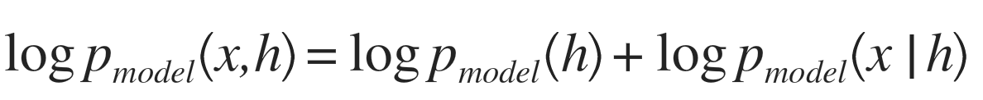
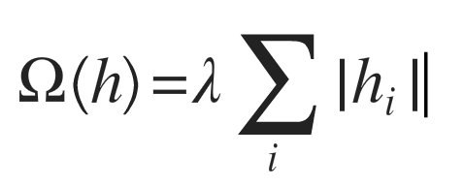
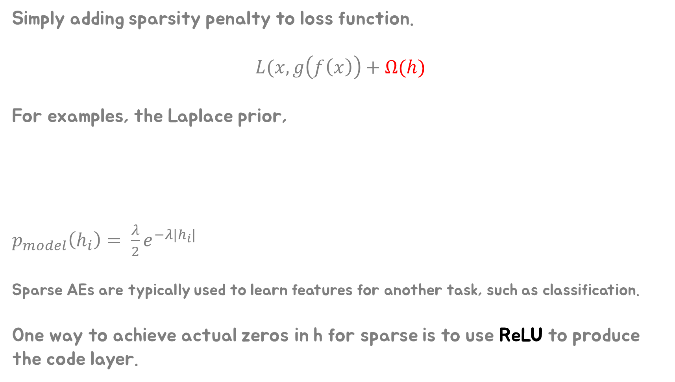
Regularized Autoencoders
Sparse Autoencoders
Simply adding sparsity penalty to loss function.
$$L(x, g\left(f\left(x\right)\right)+Ω(h)$$
For examples, the Laplace prior,
$p_{model}\left(h_{i}\right)= \frac{λ}{2}e^{−λ|h_{i}|}$
Sparse AEs are typically used to learn features for another task, such as classification.
One way to achieve actual zeros in h for sparse is to use ReLU to produce the code layer.

Slide 9
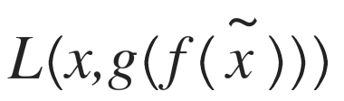
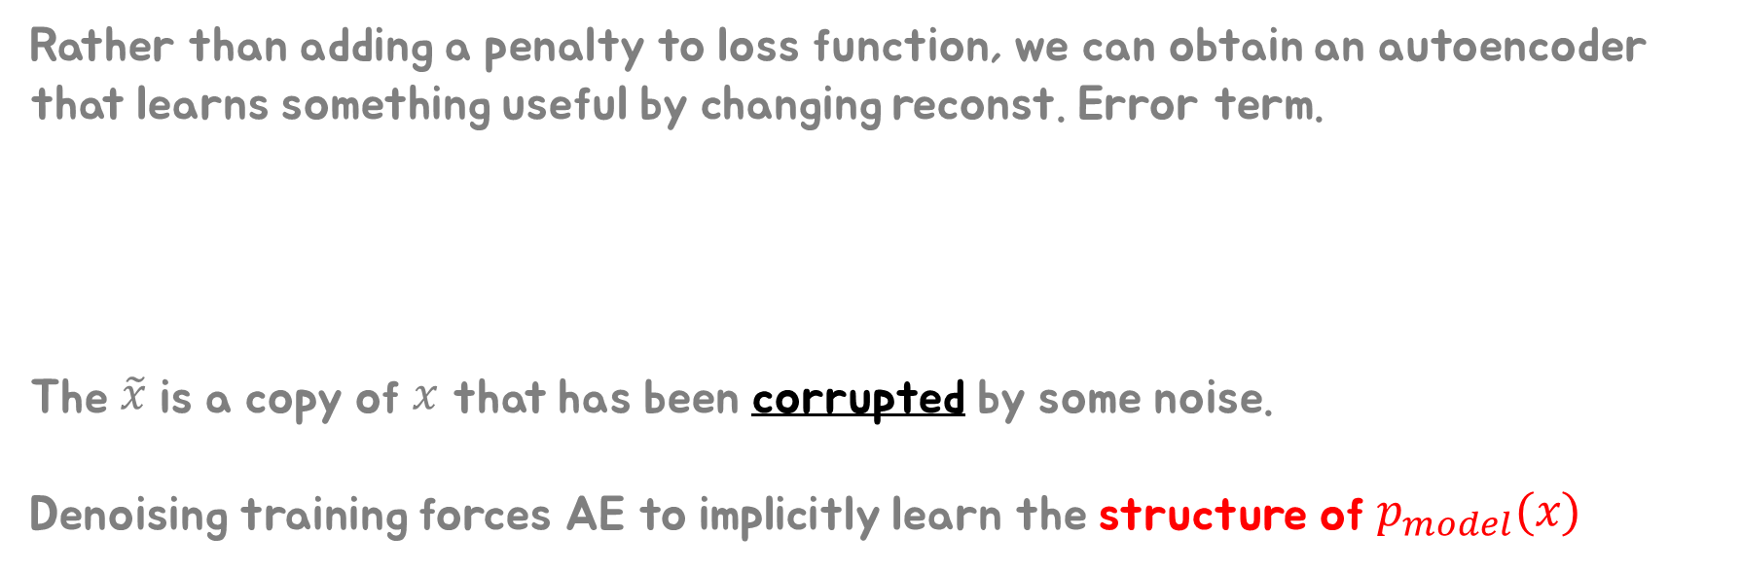
Regularized Autoencoders
Denoising Autoencoders
Rather than adding a penalty to loss function, we can obtain an autoencoder that learns something useful by changing reconst. Error term.
The $\tilde{x}$ is a copy of $x$ that has been corrupted by some noise.
Denoising training forces AE to implicitly learn the structure of $p_{model}(x)$

Slide 10
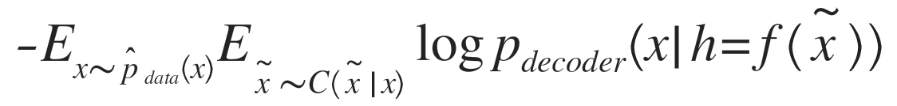
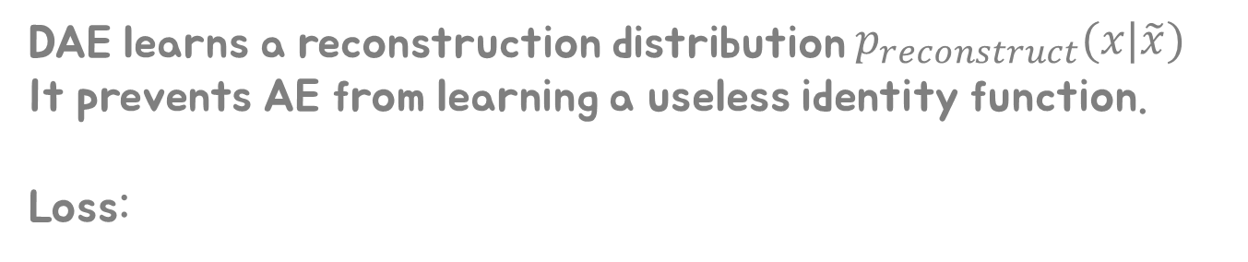
Regularized Autoencoders
Denoising Autoencoders
Corrupted input
DAE learns a reconstruction distribution $p_{reconstruct}(x|\tilde{x})$
It prevents AE from learning a useless identity function.
Loss:

Slide 11
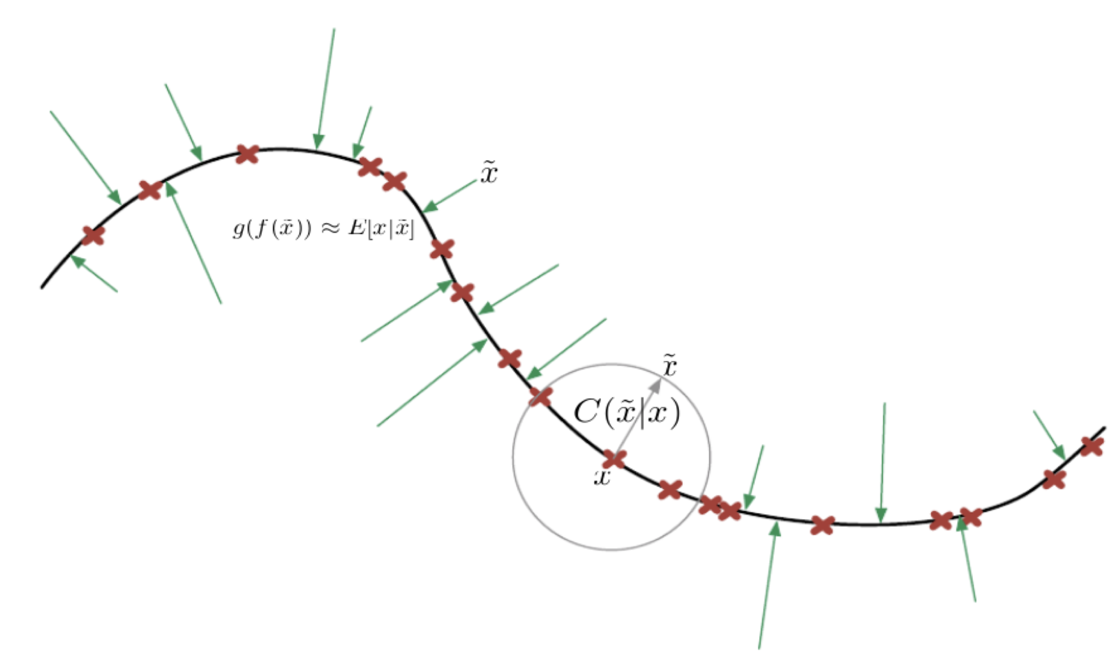
Regularized Autoencoders
Denoising Autoencoders

Slide 12
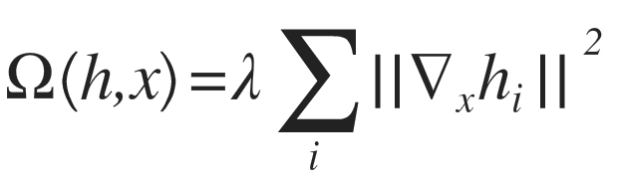
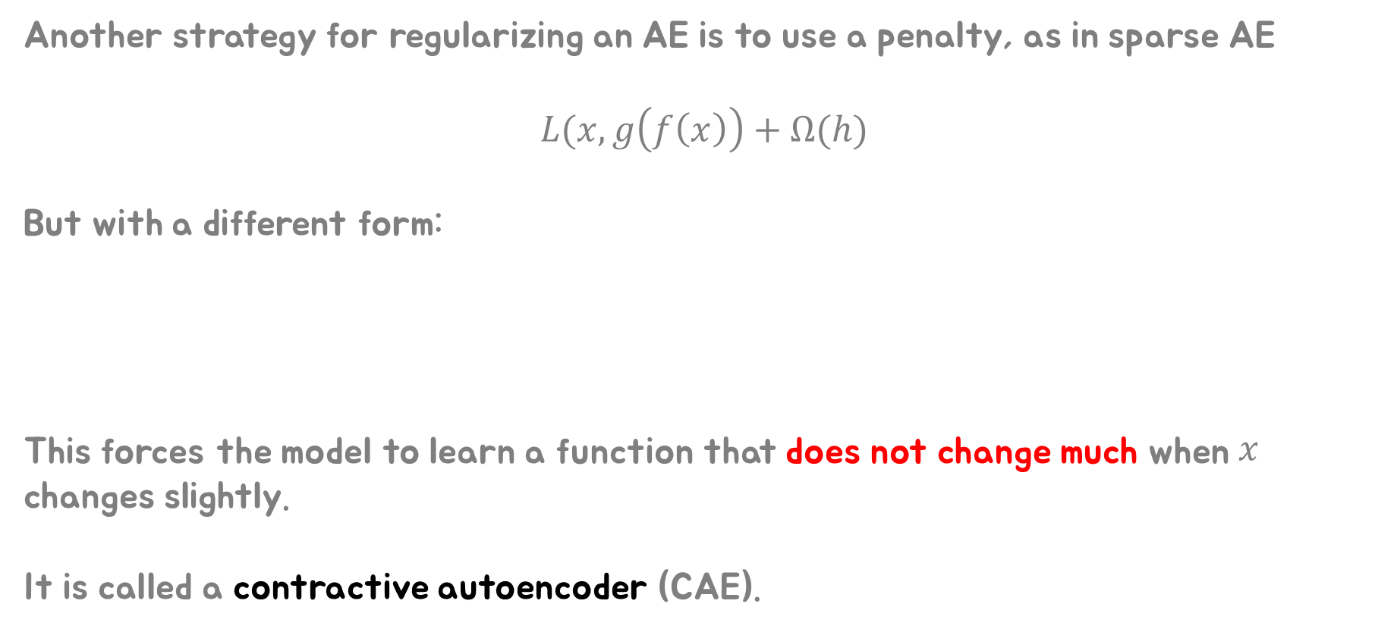
Regularized Autoencoders
Regularizing by Penalizing Derivatives
Another strategy for regularizing an AE is to use a penalty, as in sparse AE
$$L(x, g\left(f\left(x\right)\right)+Ω(h)$$
But with a different form:
This forces the model to learn a function that does not change much when $x$ changes slightly.
It is called a contractive autoencoder (CAE).

Slide 13
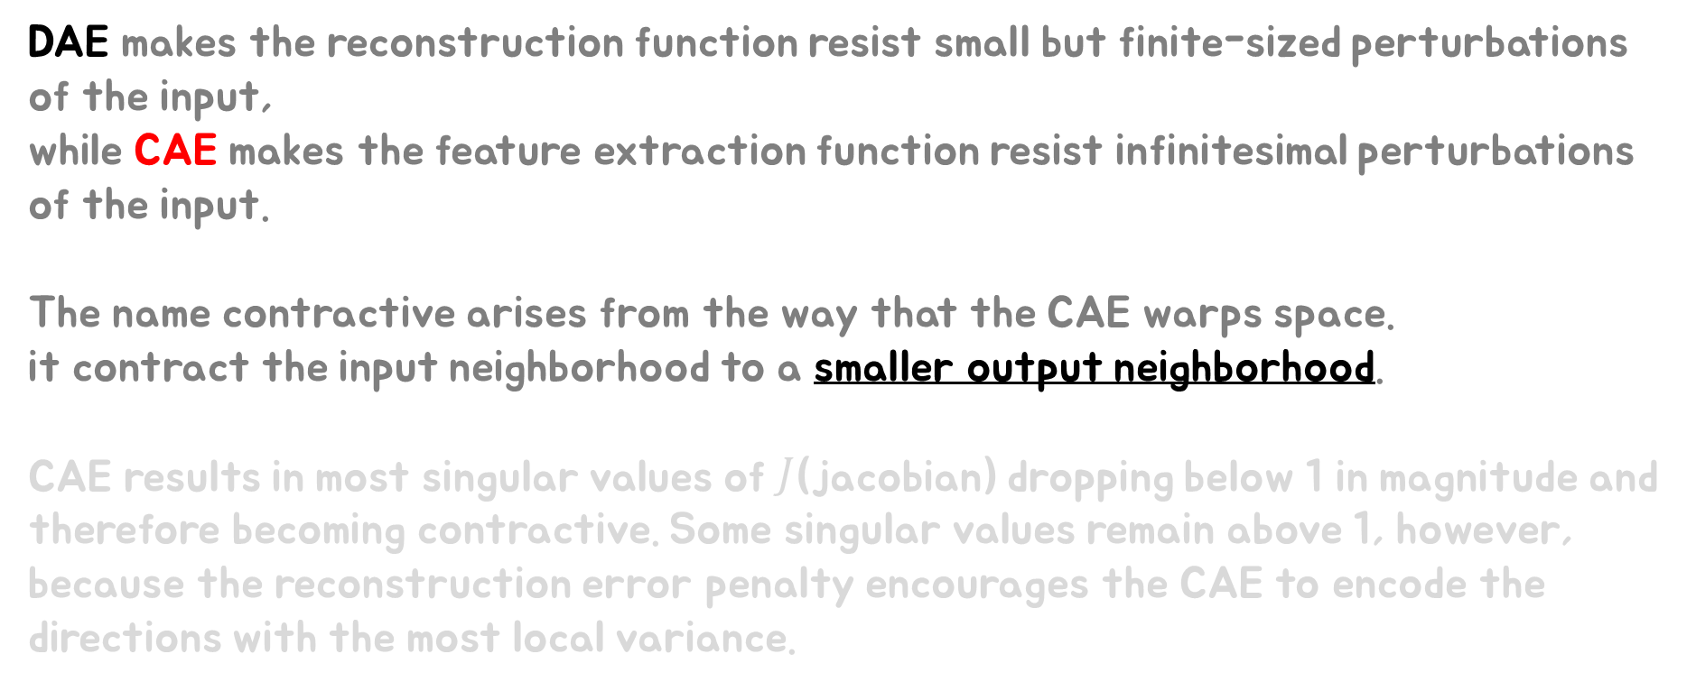
Contractive Autoencoders
DAE makes the reconstruction function resist small but finite-sized perturbations of the input,
while CAE makes the feature extraction function resist infinitesimal perturbations of the input.
The name contractive arises from the way that the CAE warps space.
it contract the input neighborhood to a smaller output neighborhood.
CAE results in most singular values of $J$(jacobian) dropping below 1 in magnitude and therefore becoming contractive. Some singular values remain above 1, however, because the reconstruction error penalty encourages the CAE to encode the directions with the most local variance.

Slide 14
Applications of Autoencoders
Dimensionality reduction
Information retrieval
Finding entries in a database that resemble a query entry.
If we train the dimensionality reduction algorithm to produce a code that is low-dim and binary, then we can store all database entries in a hash table that maps binary code vectors to entries
It is called semantic hashing.
※To produce binary codes,
one typically uses an encoding function with sigmoid on the final layer.
And inject additive noise just before the sigmoid nonlinearity during training.
The magnitude of the noise should increases over time.
To fight this noise and preserve as much information as possible, the network must increase the magnitude of the inputs to the sigmoid function.

